Slide 1
DETERMINISM & Memory allocations in labview
Mark Randel (CLA)

Slide 2

Mark Randel (CLA)
Senior Software Engineer - JKI
Over 30 years engineering
Started with LabVIEW 2.0 in 1990
Industries: Defense & Aerospace, Medical, Manufacturing, Robotics
Spent 6+ years at SpaceX (McGregor) designing and supporting Test Software infrastructure

Slide 3

#OurGiantsAreFemale
Gwynne Shotwell
President & COO SpaceX
Earned BS and MS degrees in Mechanical Engineering and Applied Mathematics from Northwestern University
Worked at The Aerospace Corporation for 10 years, becoming Chief Engineer of spacecraft program
Joined SpaceX in 2002 as Vice President of Business Development
Promoted to President and COO in 2008
Led development of Falcon rockets and Dragon spacecraft
Pioneered reusable rocket technology
Named in Time’s 100 most influential people (2020)

Slide 4


Slide 5
Determinism defined
Not the philosophical definition

Slide 6
Determinism in LabVIEW
Definition: A deterministic system is one where future states are predictably determined by current conditions, with no randomness involved.
Challenge in Windows: Windows introduces potential non-determinism due to background processes and system management.
Real-Time Operating Systems (RTOS): Even RTOS can introduce non-determinism if forced to reallocate memory.
LabVIEW Consideration: Memory allocation strategies in LabVIEW can impact deterministic behavior.

Slide 7
Ideal vs. Real World
System Rate: 200Hz
(5mSec Period)
Read (DAQ)
Scale & Math
Sequence
Write (DAQ)
Network Write

Slide 8
Memory Allocations in LabVIEW
Definition: Assignment of physical or virtual memory for program use
LabVIEW Compiler Behavior:
Predicts and reserves memory at start time
Dynamic allocations occur during runtime
Causes of Runtime Allocations:
Changes in array size
Changes in string length
Impact on Determinism:
Each allocation/resize requires Memory Manager adjustment
Adjustment time is unpredictable, introducing non-determinism
Debugging Tool:
Use Desktop Execution Trace Toolkit (DETT) to identify allocations

Slide 9
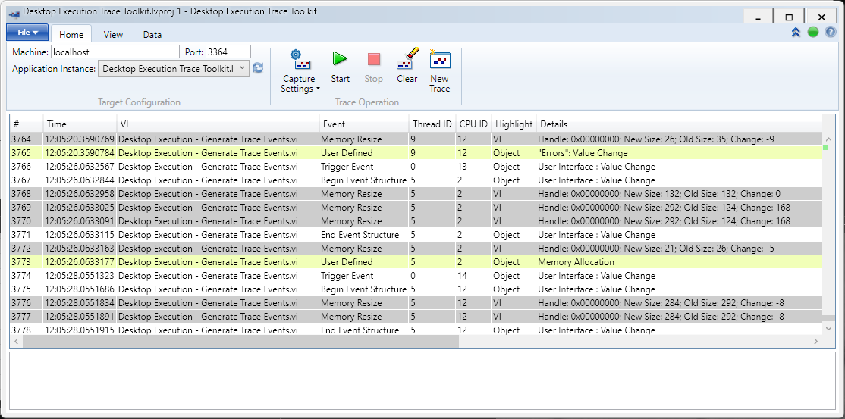

Desktop Execution Trace Toolkit (DETT) – For Further Study
Note: This presentation is not a DETT tutorial. For in-depth learning, refer to LabVIEW documentation.
Relevance to Memory Allocations:
Tracks real-time memory allocation
Helps identify unexpected allocations
Potential Benefits:
Insight into sources of non-deterministic behavior
Aids in optimizing memory usage patterns
There is much more to DETT than is covered in this presentation. (Possibly a future presentation?)

Slide 10
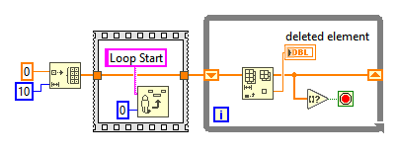
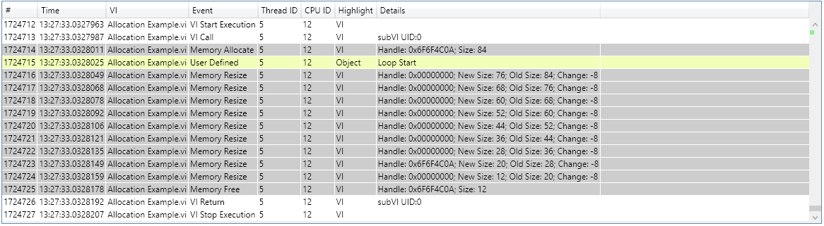
Basic Example

Slide 11
Applied to real world problems
Enough with the setup. Let’s see the goods.

Slide 12
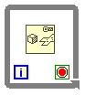
Data Transmit to Network
A control program is required to send ALL of its data out over the network
The data size can vary between a couple hundred to thousands of channels
The network protocol can only support a limited number of channels per packet
Data
[variable]
Full Packet
Full Packet
Full Packet
Full Packet
Full Packet
Partial

Slide 13
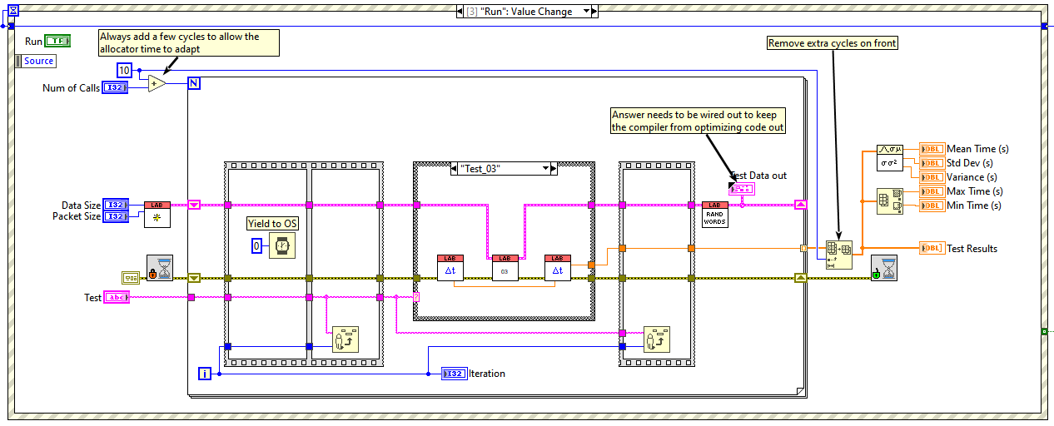
Test Setup: Platform

Slide 14
Test Setup: Memory Allocations
Data Size: 12,000 channels
Max Packet: 5,000
Resulting in:
Packet Size
[5000]
Packet Size
[5000]
[2000]

Slide 15
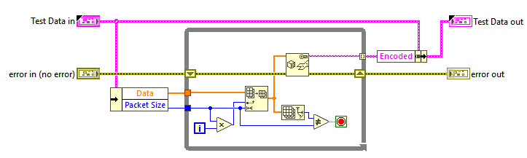
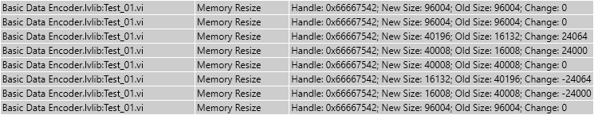
Basic Approach
Data
[12,000]
Packet Size
[5000]
Packet Size
[5000]
[2000]
DETT results with Test 1 setup

Slide 16
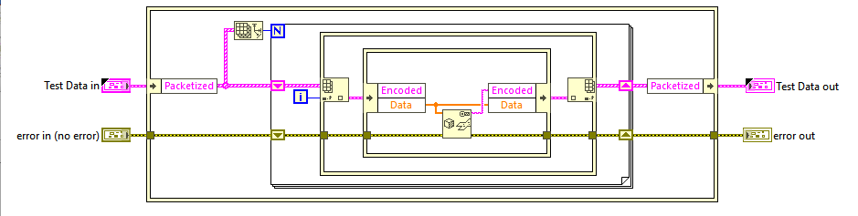
IPE’s & Pre-allocated Packet
Data[1]
(5000)
Packet Size
[5000]
Data[2]
(5000)
Packet Size
[5000]
Data[3] (2000)
[2000]
DETT results with Test 1 setup

Slide 17
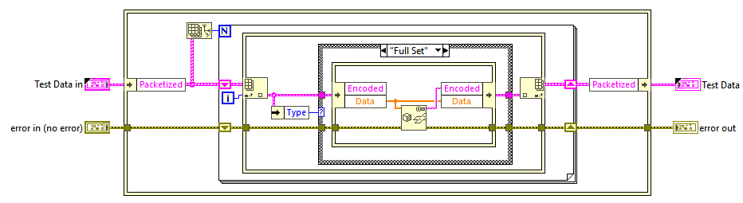
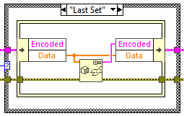
Add Packet Type Case
Data[1]
(5000)
Packet Size
[5000]
Full Set
Data[2]
(5000)
Packet Size
[5000]
Data[3] (2000)
[2000]
Last Set
DETT results with Test 1 setup

Slide 18
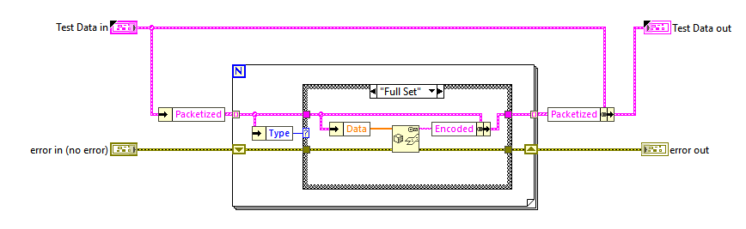
Packet Type Case (no IPE)
Data[1]
(5000)
Packet Size
[5000]
Full Set
Data[2]
(5000)
Packet Size
[5000]
Data[3] (2000)
[2000]
Last Set
DETT results with Test 1 setup

Slide 19
Test Setup: Performance
Data Size: 43,623 channels
Max Packet: 5,000
Resulting in:
Packets 1-8: 5,000 chans
Packet 9: 3,632 chans

Slide 20
Test 2: Performance
Parameters | Basic | Preallocated w/ IPE’s | Preallocated w/ IPE’s & Case | Preallocated w/ Case (no IPE’s)
Mean Time (μS) | 220.3 | 166.7 | 156.1 | 158.5
StdDev (μS) | 16.5 | 10.7 | 8.3 | 9.6
Variance (nS) | 0.272 | 0.115 | 0.068 | 0.091
Max Time (μS) | 460.8 | 298.7 | 260.8 | 302.7
Min Time (μS) | 203.7 | 155.3 | 147.9 | 148
Iterations: 10,000
Data Size: 43,623
Max Packet Size: 5,000

Slide 21
Lab Lessons Learned
Performance tests can vary. To minimize variation:
Do NOT leave DETT running
Close all sub-VI’s (front panel updates == unpredictable timing)
Don’t use debugging or probes
Close out of all other programs in Windows
Run all compared tests on the same computer
… Don’t rely strictly on performance tests
System level performance testing is the final verdict

Slide 22



Summary
Memory allocations have a direct impact on determinism
In-Place Element’s should be used with care and thought
Attempting to predict the LabVIEW compiler is complicated and changes with each new release.
When in doubt, Lab it out

Slide 23

"Before you use a sledgehammer, make sure it's not a nail."
- Unknown

Slide 24




Thank you
Mark Randel
mark.randel@jki.net

Slide 25
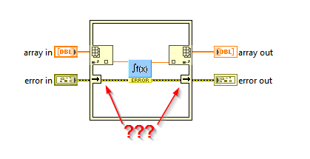
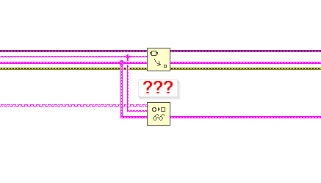
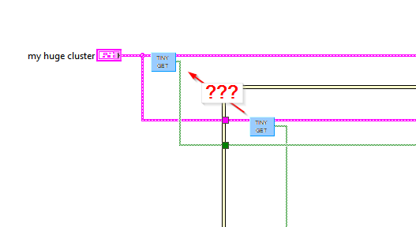
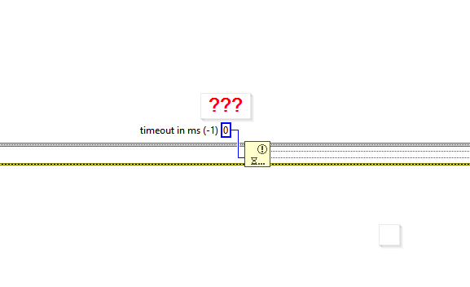

Post-Credit teaser!
Coming Soon

Slide 26
Extra slides
Data Plots

Slide 27
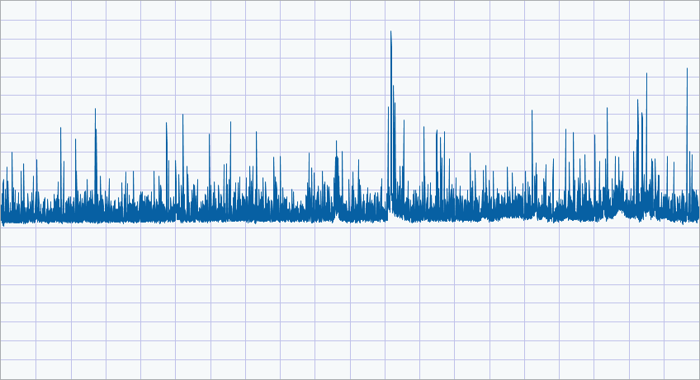
Simple Data Encoder

Slide 28
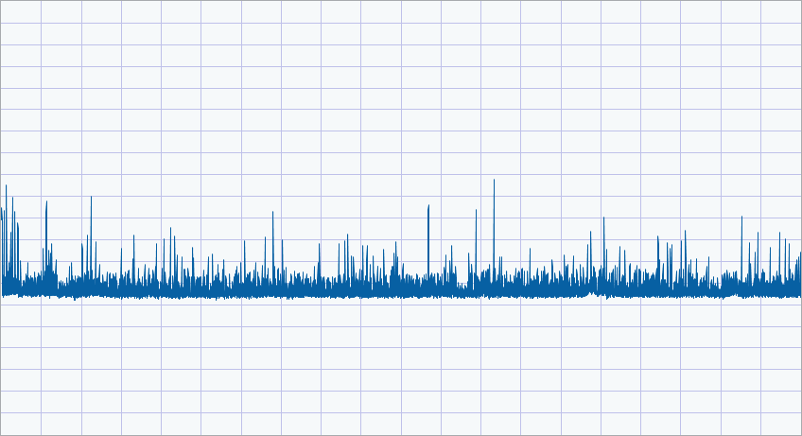
Preallocated Data Encoder

Slide 29
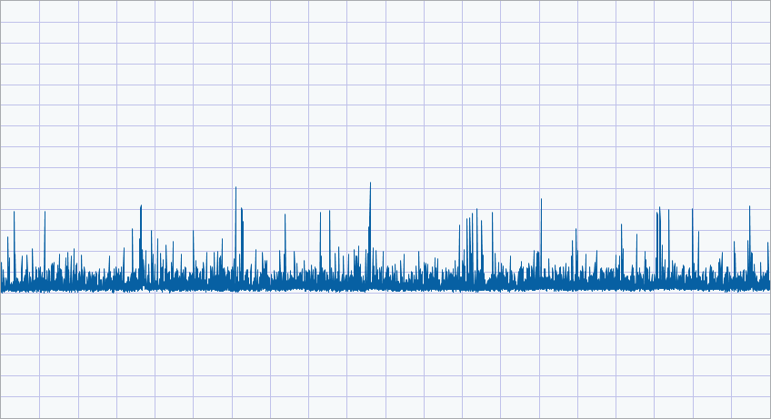
Add Packet Type Case

Slide 30
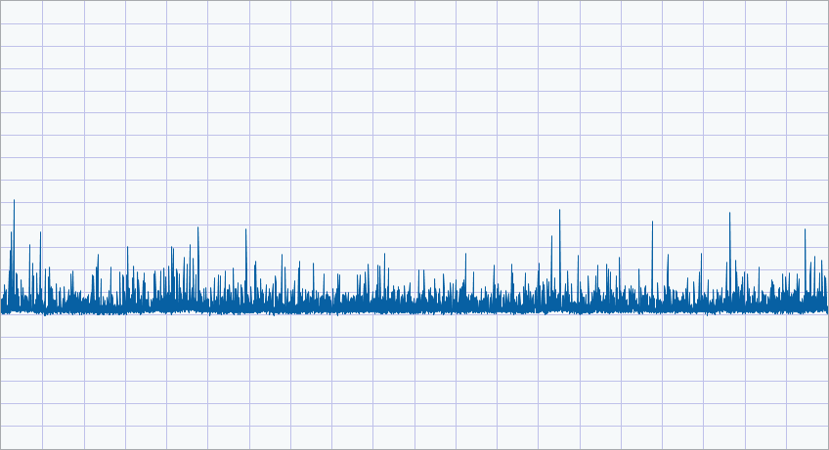
Simple Packet Type Case (no IPE)

